Slide 1
Video Displacement Measurement System
SITL, Chung-Ang University

Slide 2
Objective
Develop a 6-DOF displacement measurement system
Use Aruco markers for accurate pose estimation
User friendly interface for efficient data collection and processing

Slide 3
Project Overview
Goals and objectives of the project
Description of the 6-DOF displacement measurement system using Aruco markers
Hardware and software components used.

Slide 4
System Design
Features of the custom Tkinter-based GUI
Camera node launching, video capture testing, and calibration functionalities
Aruco marker detection and pose estimation capabilities
Data saving in CSV format for analysis.

Slide 5
System Components
Hardware
Core-i7 Intel Desktop Computer
AverMedia LIVE Streamer CAP 4K video capture cards (x 3)
Sony RX10 IV Cameras (x 3)
Software
Ubuntu 20.04
ROS Noetic
CustomTkinter
OpenCV

Slide 6
User Interface and Interaction

Slide 7
System Operation
Calibration Process
Importance of camera calibration for accurate measurements
Brief explanation of the calibration method employed.

Slide 8
Measurement Process
Steps involved in capturing and calculating displacements
Explanation of how initial poses are captured and subtracted for displacement calculation.

Slide 9
Performance Results
Summary of tests conducted (e.g., different axes displacements)
Error analysis:X-axis accuracy (less than 1 mm error)
Z-axis accuracy (more than 1 mm error)
Factors influencing accuracy (e.g., lighting conditions, marker size).

Slide 10
Data Analysis
Format and content of CSV data output
Potential data visualization and analysis methods.

Slide 11
Conclusion

Slide 12
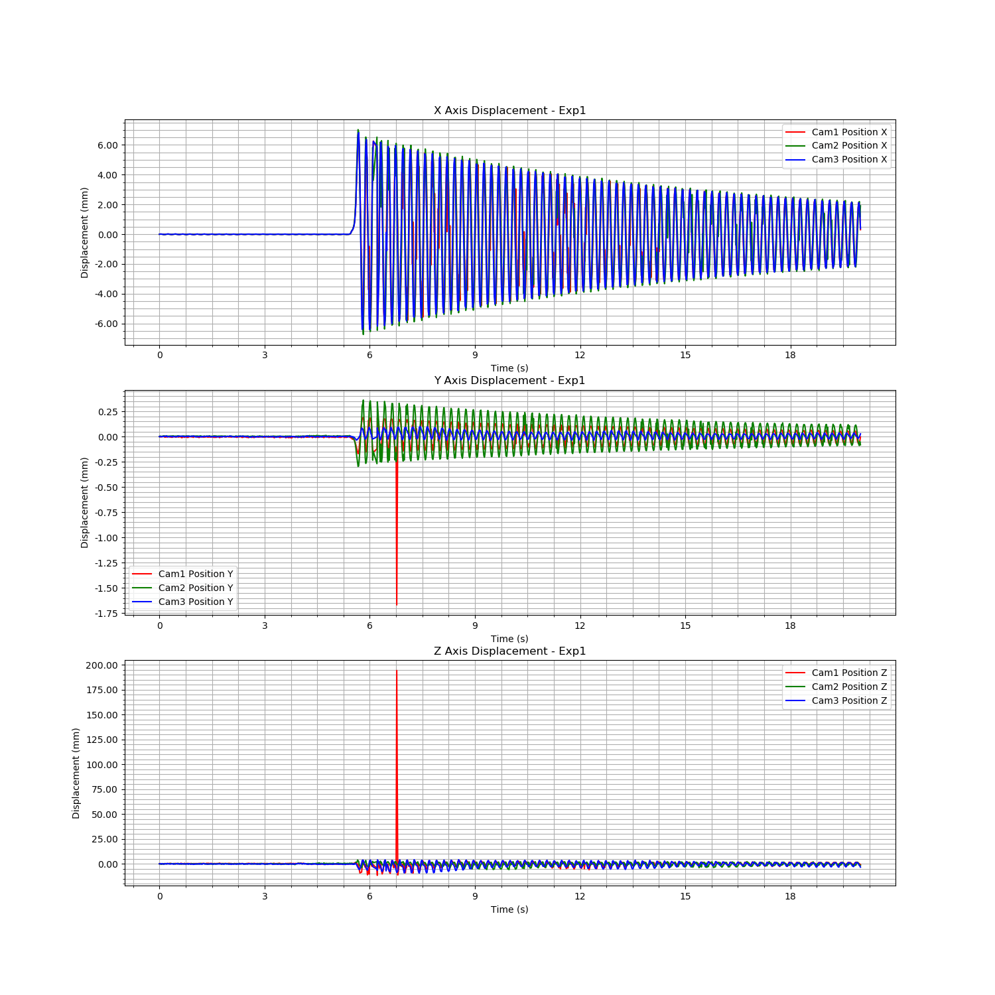
camera_data_file_path = 'data_Exp1_20s_2024-07_16_09_24_03.csv' camera_data = pd.read_csv(camera_data_file_path) # Load the LDV data from the uploaded CSV file ldv_data_file_path = 'protocol_optoNCDT-ILD1420_2024-07-16_09-24-00.721.csv' ldv_data = pd.read_csv(ldv_data_file_path, skiprows=6, delimiter=';')

Slide 13
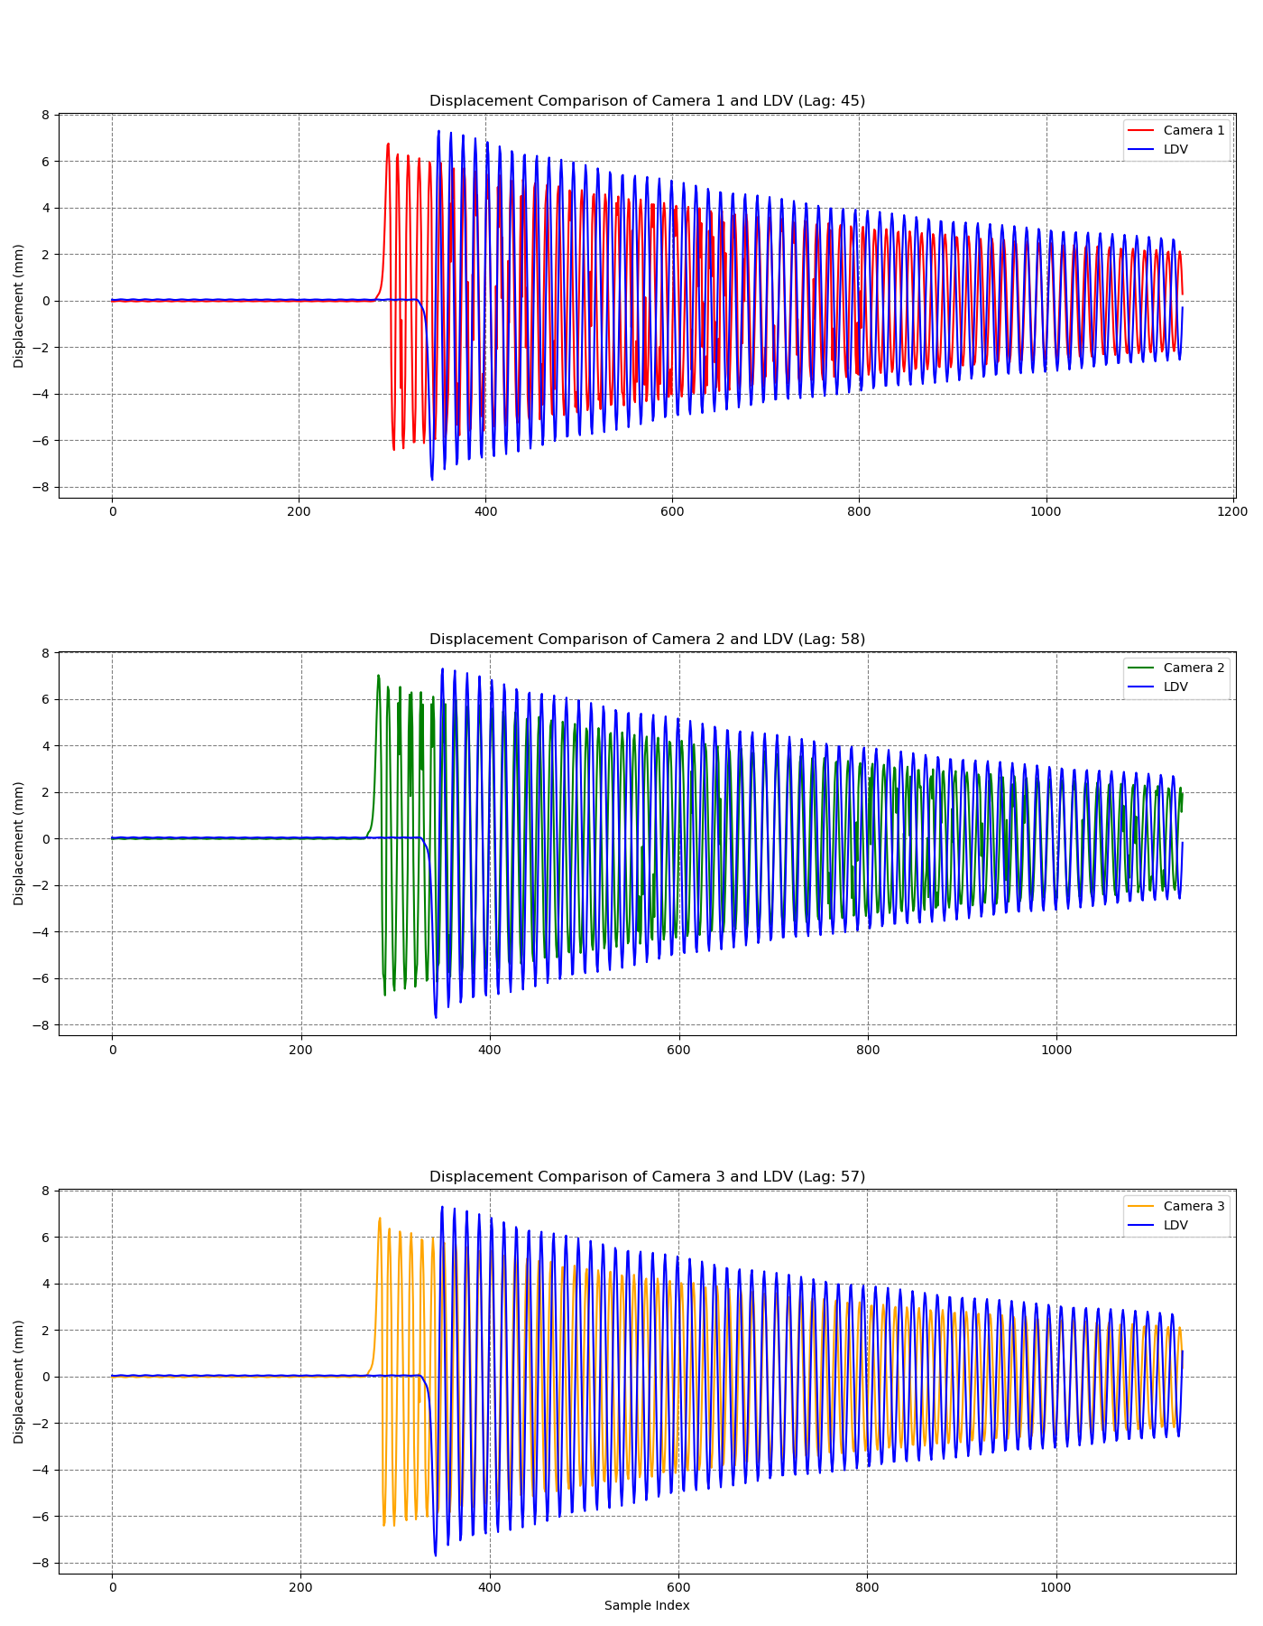

Slide 14
